Slide 1



Slide 2


Slide 3
Team 5.06

Slide 4

Team 5.06

Slide 5

Problem: The Invisible Patient
Home-based, family caregivers are underserved
Team 5.06
1
2
3
Lack of Training for Clinical Tasks
Lack of Caregiver Acknowledgement by Providers
Significant caregiver burden

Slide 6
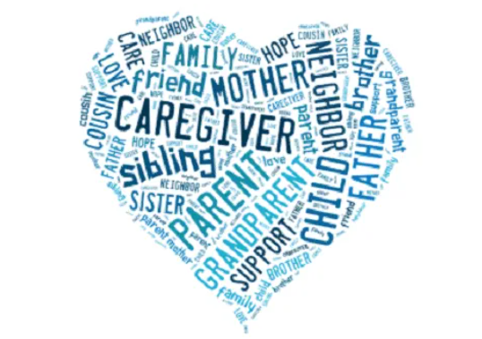
The Solution
Team 5.06
What did we create?:
A virtual home ...where no caregiver is ever alone... in their journey to assist…..ESSI
Our site provides access to:
Education
Socialization
Supportive Care
What sets us apart?
Focus is on the needs of the caregiver ….not the patient
Caregiver Stress Burden assessment ….allows us to create a personalized plan of care
Notes:
What sets us apart is that we identify this population as this invisible patient who are neglected from the health care system. We provide a platform where caregivers can obtain personalized care plan based on their Caregiver Stress Burden assessment result. Essi brings a welcoming place for caregivers to connect, learn, and to socialize with others in similar situations.

Slide 7
What sets us apart?
Team 5.06
Benefits | Essi | Competitor(s)
Education Material
Support Services
Individual Care Plans
Community Engagement
Cost
24/7 Access to Experts

Slide 8
Current Available Solutions
Team 5.06
Geriatric care managers
Facebook / Reddit (Socialization)
Youtube educational (videos)
Home health

Slide 9
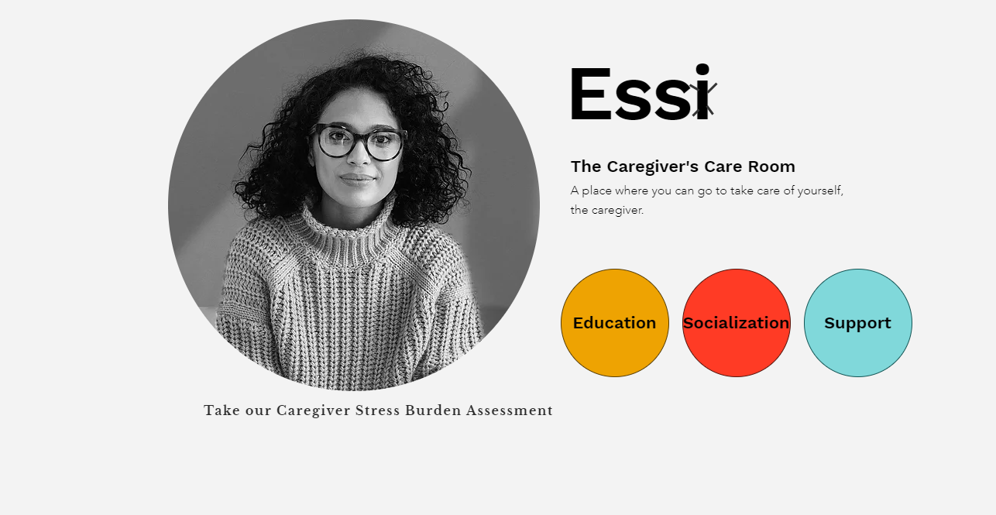
Team 5.06

Slide 10
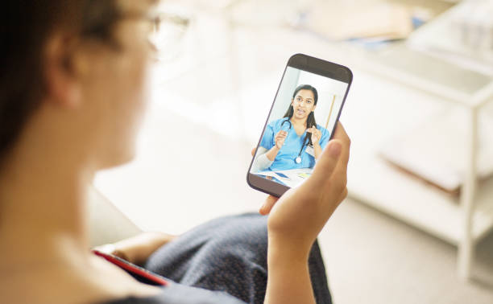
Business Model
Team 5.06
Revenue Streams:
Freemium
Free: access to community
Paid ($10 / month): access to videos + support groups
Add-on services ($60 for 30 minutes): conversations with NP who can prescribe medications + educate & train caregiver
Ads
Caregiver Products
Implementation Costs:
App Development: ~$50,000
Nurse Navigator: $25 / hr
Nurse Practitioner: $50 / hr
Notes:
There are 3 different revenue streams, all of which are highly profitable. For free, members get access to a community platform with other caregivers, to feel like they’re not alone. For $10 / month, they get access to support groups as well as educational and training videos on providing the medical-related tasks they perform like wound care, insulin injections and more. Further, caregivers who really want to get in touch with a nurse to talk through certain care-related tasks.

Slide 11
Scalability
Team 5.06
Stakeholder
Benefits to Stakeholder
Unpaid Caregivers
Strengthen connection with caregiver community
Educate and train on nursing care tasks
Provide transparent information on quality of senior care providers
1
Providers
Ensure their patients are receiving support, education and training at home
Relieve the burden of their nurses on staff
2
Managed Care Plans
Achieve cost savings from better outcomes
Achieve revenue growth from Star Ratings and membership base
Strengthen engagement with caregiver populations
3
Notes:
This solution is highly scalable.

Slide 12
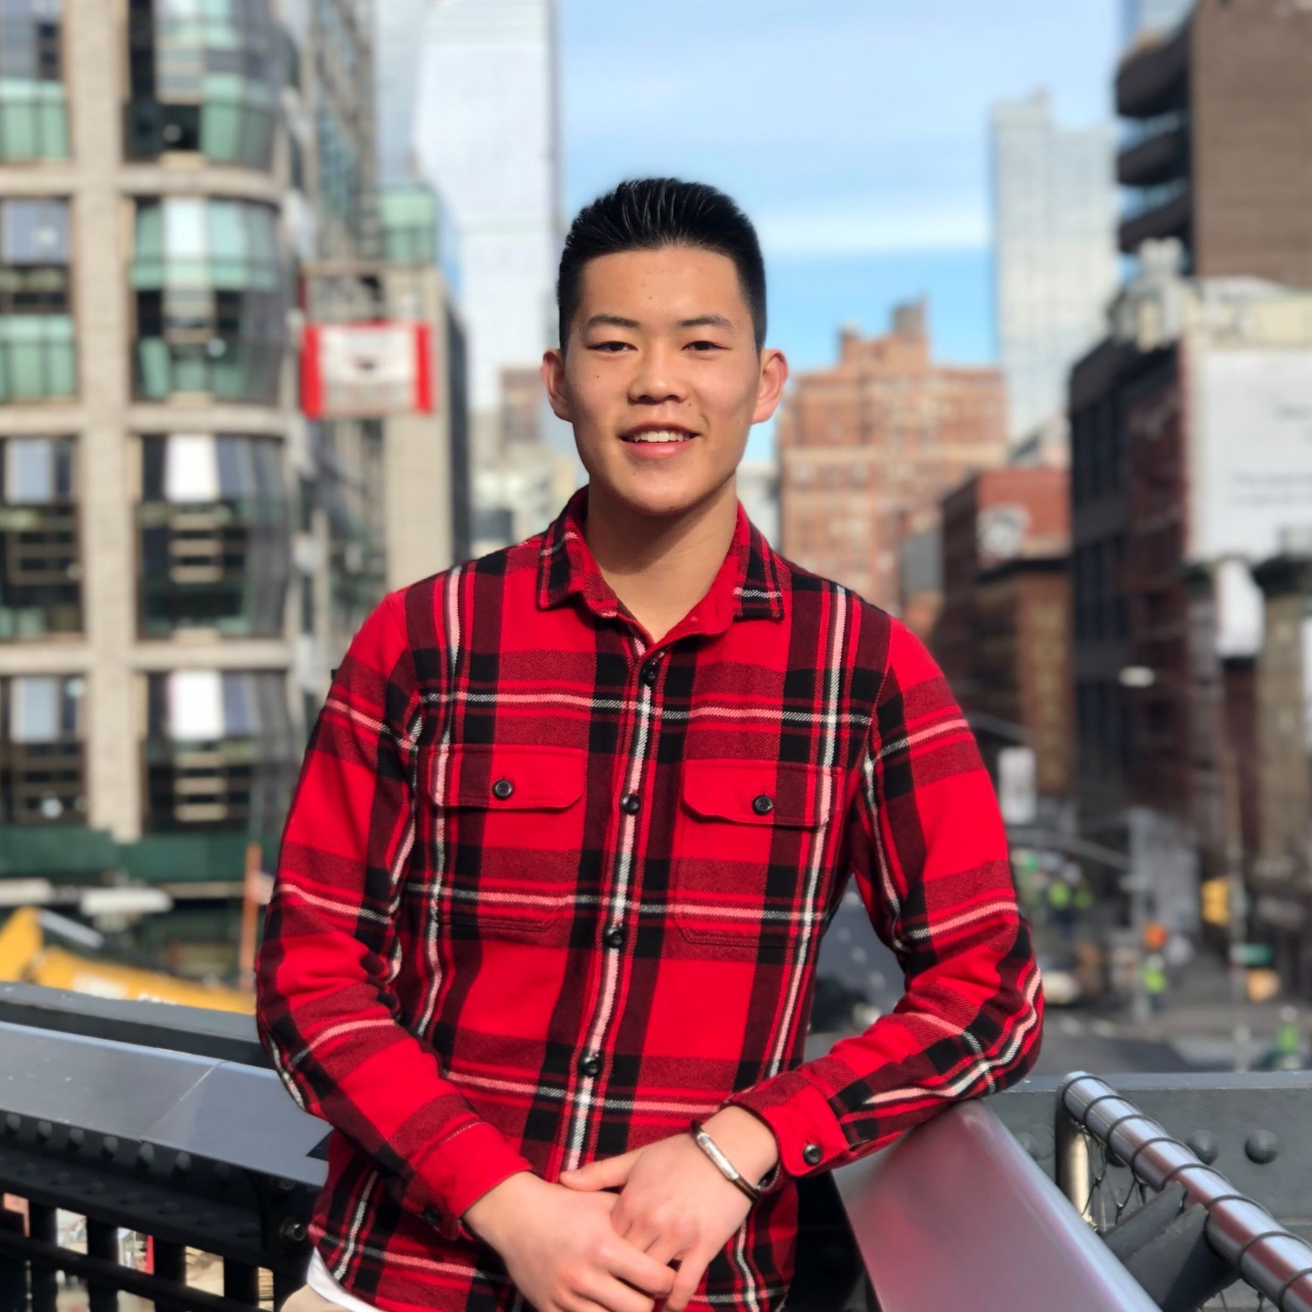
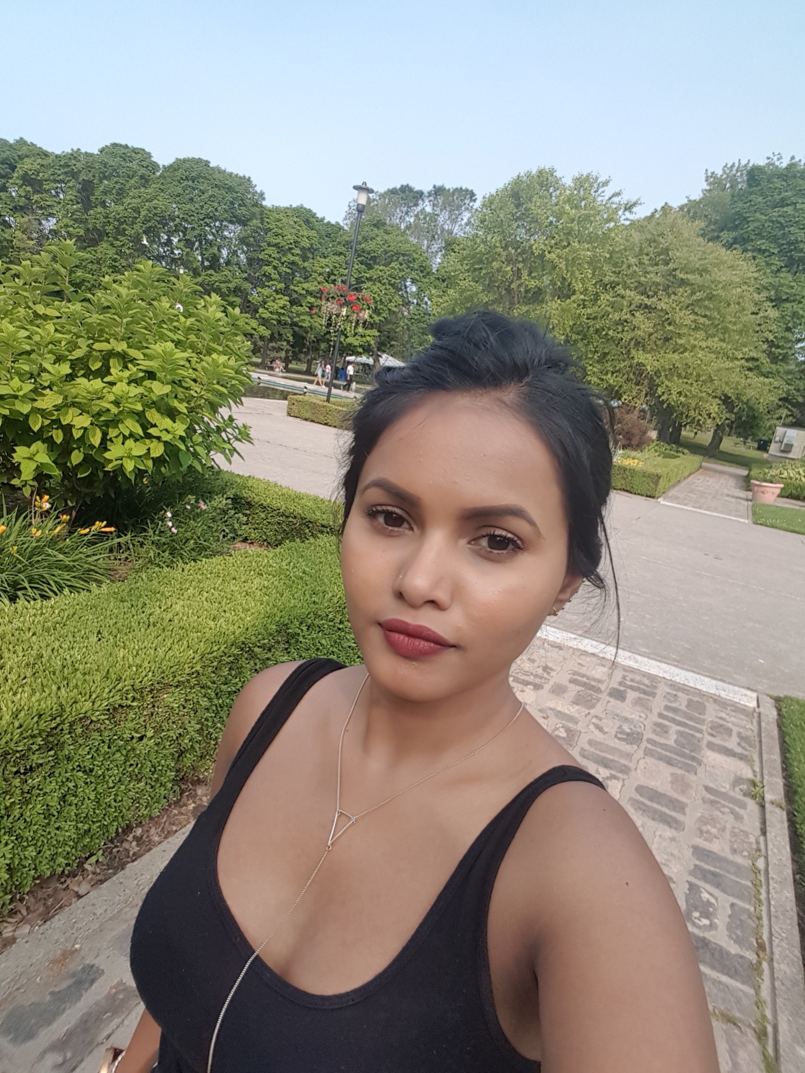
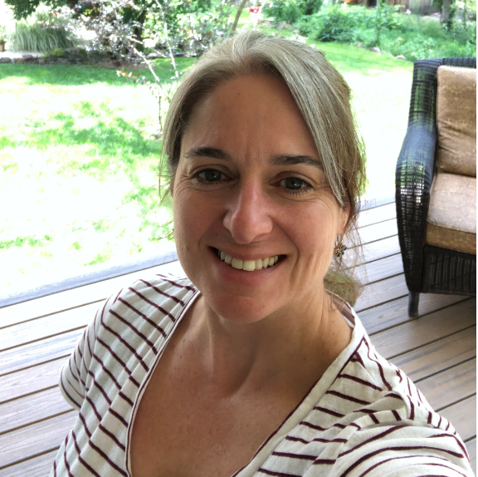
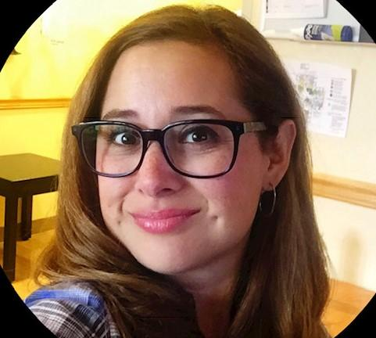
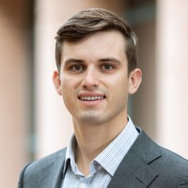
The Team
Team 5.06
Sasina Ratnasingam
Background:
RPN, RN
ICU RN
Oncology
Amy Musto
Background
MSN, RN
PMP
Janssen R&D
PMO Oncology
Lexie Arce-Pickrell
Background:
MSN
APRN
WHNP
FNP-BC
Brandon Faresich
Background:
Caregiver for grandma
Telehealth Executive
Healthcare Investor
Jonathan Zhu
Background:
Nursing Student
Senior Assisted Living Volunteer

